Slide 1
The Battle of Neighborhoods
Finding top US cities with highest number and density of Peruvian restaurants

Slide 2

Problem
A foods distributor is interested in importing and delivering autochthonous Peruvian groceries and produce to Peruvian restaurants in United States.
He is not sure where to start his business and would like to know:
What are the top 5 cities by population
What city has the lowest restaurant mean distances to their mean coordinates, so he can maximize the food delivery process.
With that information, what is the best two city for his business according to his requirements above.

Slide 3
Data
Two different data sources will be used on this project to solve the problem:
List of United States cities by population
Source: https://en.wikipedia.org/wiki/List_of_United_States_cities_by_population
Foursquare API
Source: https://foursquare.com/developers/

Slide 4
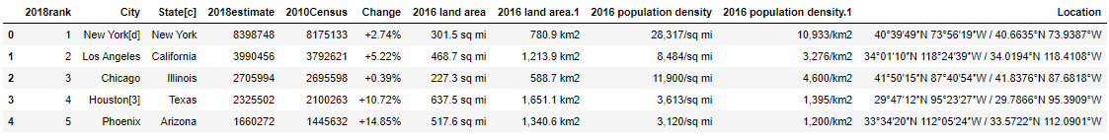
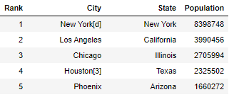
Metodology
Top US cities data was retrieved from Wikipedia
Then, data was wrangled to update headers and keep only the required columns

Slide 5
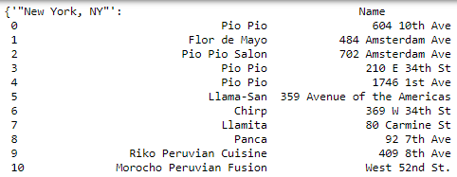
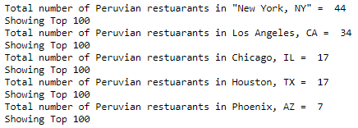
Metodology
Foursquare API was called to get the restaurant list for each city
Also the total amount of restaurants by city was retrieved

Slide 6
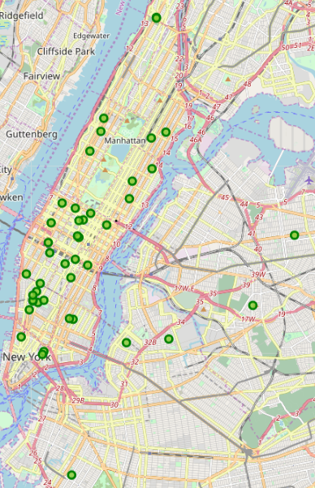
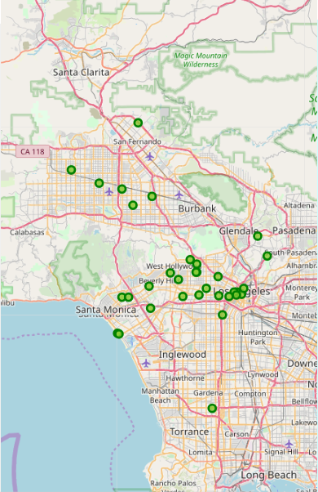
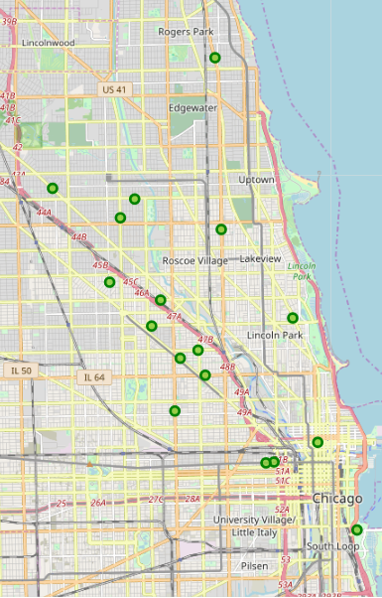
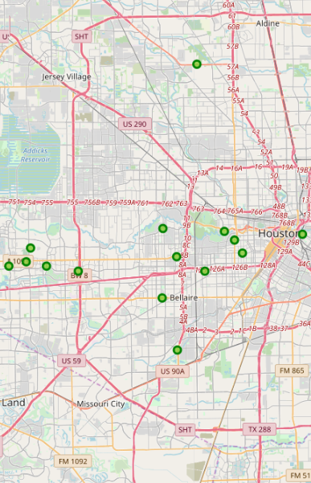
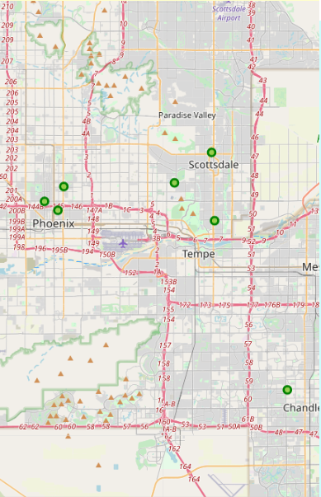
Methodology
Folium was used in this project to obtain a visual representation of the quantity and location of the Peruvian restaurants by city and to get geographical insights.
New York: 44
Los Angeles: 34
Chicago: 17
Houston: 7
Phoenix: 7

Slide 7
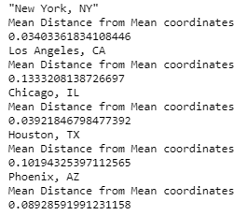
Metodology
Getting the mean location of the restaurants in each city and calculating the average distance of the restaurants to the mean coordinates.
Results:

Slide 8
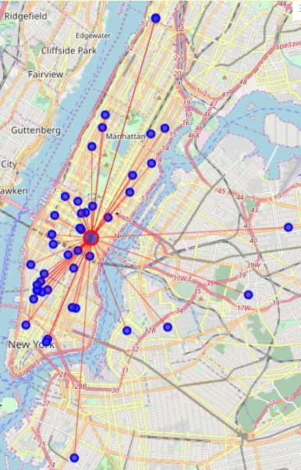
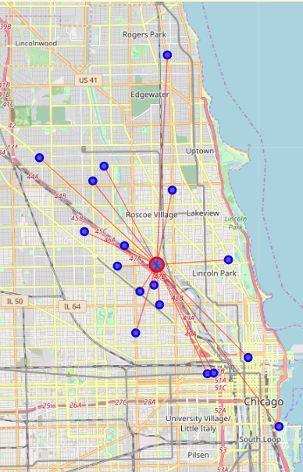
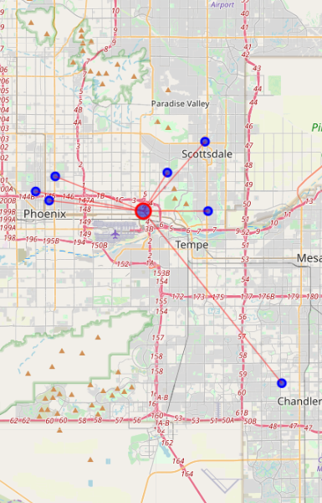
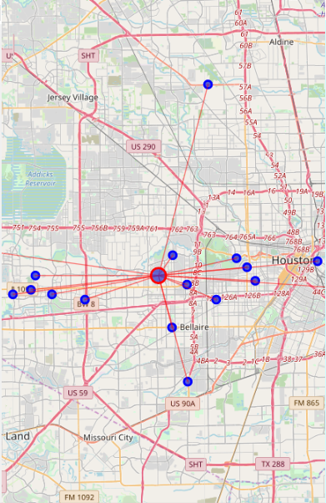
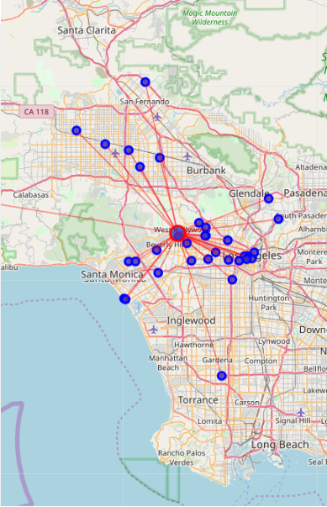
Methodology
Showing the Mean coordinate and the mean distances to mean coordinate(MDMC).
Cities ordered from lower to higher mean distances:
New York: 0.034
Chicago: 0.039
Phoenix: 0.089
Houston: 0.101
Los Angeles: 0.133

Slide 9
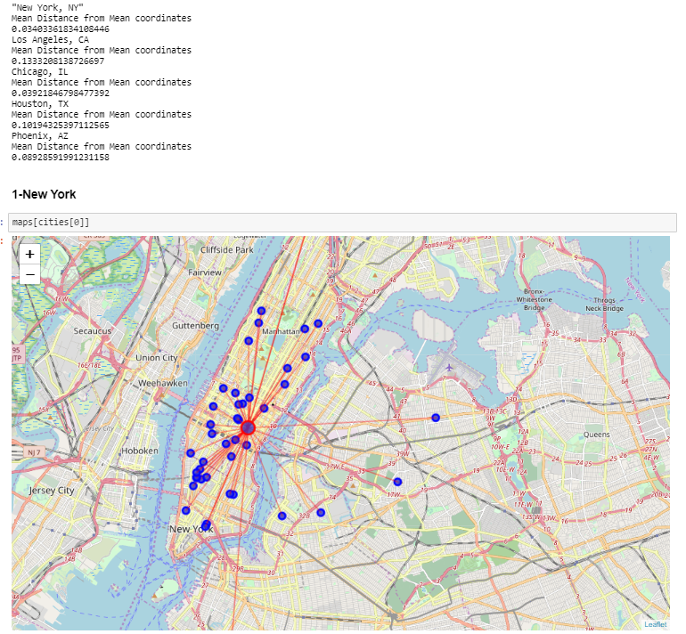
Results
It was determined that New York city has the lowest mean distance (0.034) compared to the other cities, and therefore the highest restaurant density among all cities.
Another advantage New York has is the total amount of Peruvian restaurants (44), which is the highest and combined the lowest mean distance, makes it the best option for goods delivery, as restaurants are closer together, maximizing delivery routes and delivery times; and increasing potential sales, therefore this is the option recommended to the customer.

Slide 10
Discussion
Even though customer request did not mention the number of restaurants per city as a factor to decide the best option, it is a very important factor.
By analyzing the best (lowest) mean distances, it was shown that Chicago was the second-best option; however the total amount of restaurants (170) was just half of Los Angeles amount (34), and you might think that the most restaurants you have available to deliver your goods, the more chance of getting more profits; therefore this outcome has to be mentioned to the customer, so he can take into consideration and make a more educated decision.
Data also showed one city (Phoenix) could be ruled out right away, as it showed considerable bigger mean distances and its restaurant numbers were very low (Just 7).
Finally, considering the highest populated cities does not mean they have the biggest amount of (Peruvian restaurants) in this case, and that is something we -as future data scientists- should take into consideration, to understand the business needs and anticipate any variables to deliver a better result than just what the customer requested.

Slide 11
Conclusion
There are many real-life situations where data along with technology can be used to find solutions to most problems; either by just analysis or by training existing data to predict future outcomes.
Having the right tools and the knowledge can make a big difference for the future of a business; for instance, the fictional problem developed in this project got great insights from using Foursquare API and data science tools to determine the best options, therefore decision could be made based in facts, and even though, they were just a small sample of all the variables to take in consideration, they showed how important data is.
This project was just a small taste of what can be accomplished by implementing data science to the decision-making process.

Slide 12
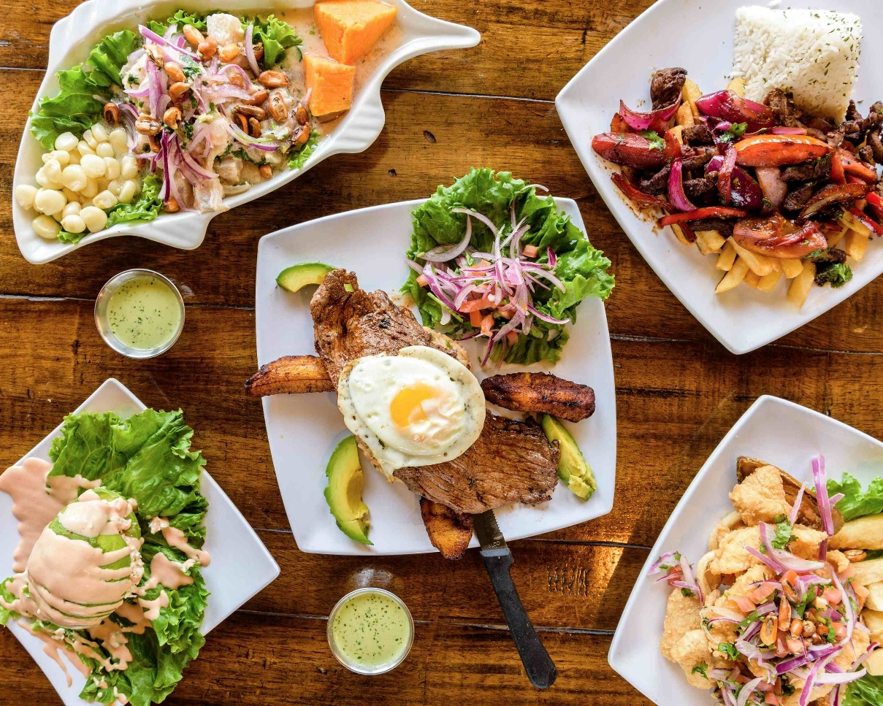
Thank you!

